Slide 1
Lynx TVAC and Temp Cycle Spec.
[PA-907] The first and last cycles shall include a 6 hour soak at the cold and hot plateaus, ending with the hot cycle to prevent moisture contamination. Intermediate cycles shall be no less than one 1 hour at each plateau.
[PA-909] The first cycle shall include a power-off cold and hot soak to the requirements of PA-797 for one hour. Performance at ambient must be demonstrated after returning to the maximum performance temperature or ambient.
Table 17: Minimum Thermal/TVAC Testing Cycles

Slide 2
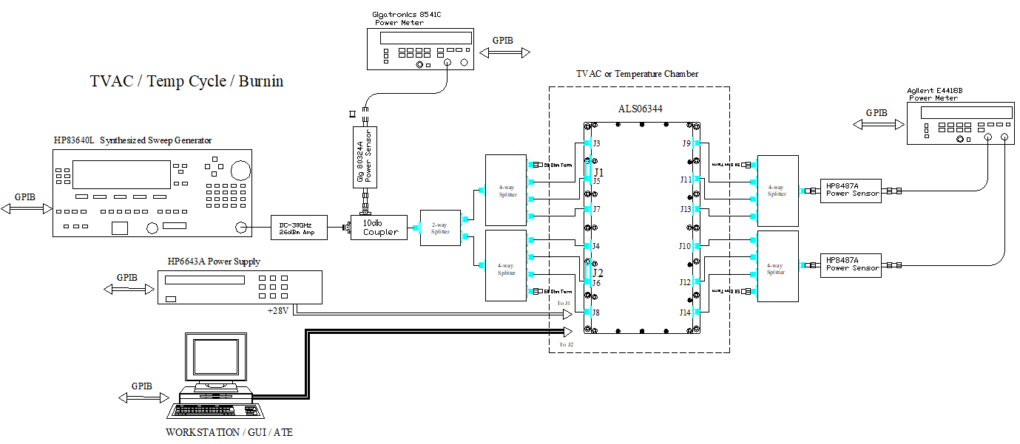
Lynx TVAC and Temp Cycle Set-up
Only the ALS06344 DUT will be in the chamber
RF in/out cables and DC/Control wires will be routed thru the chamber feed-thru
Calibrated input CW power of -10dBm into each of the modules will be implemented by using 2-way and 4-way splitters
2 sets of 4-way splitters will be used to monitor the output power of each module; 1 splitter to measure the horizontal amplifier modules and 1 splitter for the vertical amplifier modules
ATE software will perform the following:
Thru the DUT control interface:
send band select and gain commands to the DUT and record mtemp telemetry and other telemetry.
Thru the GPIB interface:
Measure and store input / output offsets for each amplifier path
Set input power
Record input and output power for each amplifier path
Record current draw

Slide 3
Lynx TVAC and Temp Cycle Set-up
Measure input splitter offsets from coupled port to each of the 6 splitter outputs. These are the input power meter offsets used to set input power of -10dBm for each of the 6 amplifier modules and save the input splitter offsets into the ATE.
Measure output splitter offsets to each of the output splitter inputs. These are the output power meter offsets used to measure output power of each amplifier module and save the output splitter offsets into the ATE.
Recall J3 input offset and J9 output offset to measure band 1 horizontal amplifier module
Set the DUT to enable band 1 and gain to max value
Set signal generator CW freq to 3 GHz and turn on RF power
Adjust signal generator power level to obtain input power level of -10dBm
Record input power reading from input power meter into ‘Band 1 Horizontal input power’ in the test data log.
Record output power reading from output power meter channel 1 into ‘Band 1 horizontal output power’ in the test data log.
Record current draw from the power supply and mtemp output of the DUT
Repeat above steps for the remaining input/output ports, bands and CW frequencies outlined in the table below
The ATE will continuously execute all the above steps through the entire duration of the temp / TVAC cycles
Input port | Output Port | Band | CW Freq | Output power meter Channel # | Input power data log (input power meter) | Output power data log (output power meter)
J3 | J9 | 1 | 3 GHz | 1 | Band 1 horizontal | Band 1 horizontal
J5 | J11 | 2 | 12.5 GHz | 1 | Band 2 horizontal | Band 2 horizontal
J7 | J13 | 3 | 28 GHz | 1 | Band 3 horizontal | Band 3 horizontal
J4 | J10 | 1 | 3 GHz | 2 | Band 1 vertical | Band 1 vertical
J6 | J12 | 2 | 12.5 GHz | 2 | Band 2 vertical | Band 2 vertical
J8 | J14 | 3 | 28 GHz | 2 | Band 3 vertical | Band 3 vertical

Slide 4
Additional Steps/Comments
Updated process steps defined in excel file.
During 6Hr soak step, the unit will be in a specific Band for a min. of 1Hr.
During normal monitoring, the unit will switch band at a min. of every 10 minutes.

